Slide 1

JS Design Patterns
Following Best Practices
SoftUni Team
Technical Trainers
Software University
http://softuni.bg

Slide 2
Table of Contents
What is a Pattern?
The "Gang of Four" design patterns
Design Patterns
Module & Revealing - Module
Prototype
Pub/Sub

Slide 3

Design Patterns
Definition and Structure

Slide 4
What is a Pattern?
Design Pattern - reusable solution that can be applied to commonly occurring problems in software design
They have 3 main benefits:
Proven solutions - solid approach
Easily reused
Can be expensive

Slide 5
Categories of Design Patterns
Design Patterns can be broken down into a number of different categories:
Creational
Structural
Behavioral

Slide 6
Creational Design Patterns
Focus on handling object creation mechanisms
These patterns control the creation problems
Some of the patterns that fall under this category are:
Constructor
Factory
Prototype
Singleton

Slide 7
Structural Design Patterns
Focus on object composition
Ensure that when one part of a system changes, the entire structure of the system doesn't need to do the same
Some of the patterns that fall under this category are:
Decorator
Facade
Adapter
Proxy

Slide 8
Behavioral Design Patterns
Focus on improving or streamlining the communication between disparate objects in a system
Some of the patterns that fall under this category are:
Iterator
Mediator
Observer
Visitor

Slide 9

Module & Revealing - Module
Encapsulating Data

Slide 10
The Module Pattern
Modules help keep the units of code for a project both cleanly separated and organized
The pattern shields particular parts from the global scope
The main goal is to achieve privacy

Slide 11
"Module" Pattern (with Object Literal)
let moduleObj = {
count: 0, // public
increase: function(num) { return this.count += num },
decrease: function(num) { return this.count -= num },
value: function() { return this.count }
};
moduleObj.count = 2; // the counter is accessible
console.log(moduleObj.value()); // 2
console.log(moduleObj.increase(5)); // 7
console.log(moduleObj.decrease(1)); // 6

Slide 12
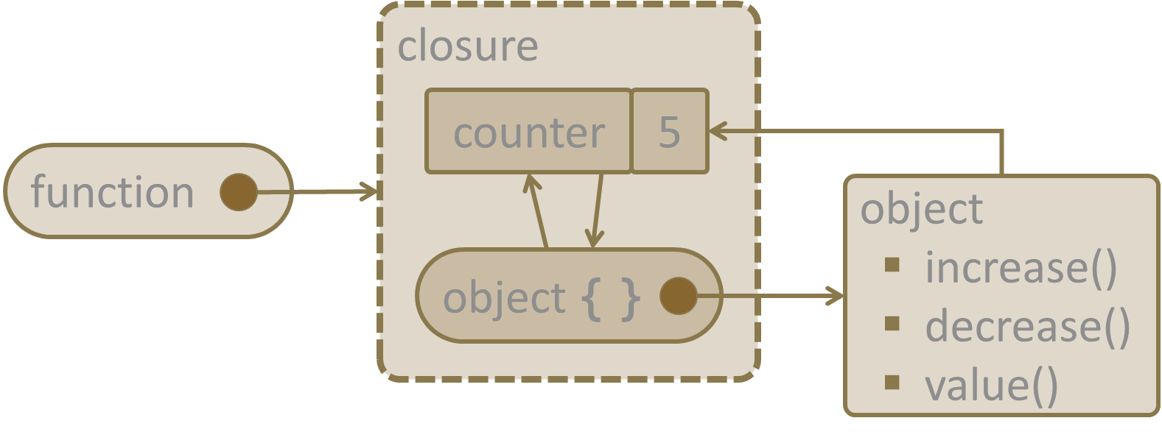
"Module" Pattern (with Closure)
let module = (function() {
let count = 0; // private
return {
increase: (num) => count += num,
decrease: (num) => count -= num,
value: () => count,
};
})();
console.log(module.value()); // 0
console.log(module.increase(5)); // 5
console.log(module.decrease(2)); // 3
console.log(module.count); // undefined (not accessible)

Slide 13
"Revealing Module" Pattern (with Closure)
let revModule = (function() {
let count = 0; // private
function change(amount) { return count += amount; }
function increase(num) { return change(num); }
function decrease(num) { return change(-num); }
function value() { return count; }
return { increase, decrease, value };
})();
console.log(revModule.value()); // 0
console.log(revModule.increase(5)); // 5
console.log(revModule.decrease(2)); // 3
console.log(revModule.count); // undefined (not accessible)

Slide 14
__proto__
Prototype Pattern
Object Composition

Slide 15
The Prototype Pattern
Based on prototypal inheritance
Used to instantiate new objects by copying all of the properties of an existing object
Particularly useful when the construction of a new object is inefficient and expensive

Slide 16
Prototype Inheritance
Use Object.create() to achieve a prototypical inheritance
let person = {
name: 'George',
email: 'george@gmail.com',
sayHello: function() {
console.log(`Hello ${this.name}!`); }
}
let clonedPerson = Object.create(person); // new instance
console.log(Object.getPrototypeOf(clonedPerson));

Slide 17
Publisher
Event
Bus
Subscriber
Pub/Sub Pattern
The Event Bus

Slide 18
What is Pub/Sub?
Messaging pattern
Senders (publishers), do NOT program the messages to be sent directly to specific receivers (subscribers)
Subscribers express interest in one or more events and only receive messages that are of interest
In this model, subscribers typically receive only a subset of the total messages published

Slide 19
What is Pub/Sub?
Pattern used to communicate messages between different system components
They don't know anything about each other's identity
Provides great network scalability and a more dynamic network topology
Decreased flexibility to modify the publisher and the structure of the published data

Slide 20
Pub/Sub Example
An intermediary, called a "message broker" or "event bus"
Receives published messages
Forwards them on the subscribers who are registered to receive them
Subscriber
Publisher
Event
Bus
Subscriber
Publisher
Subscriber
Publisher
Subscriber

Slide 21

Advantages
Eliminate Polling
Promotes faster response time and reduces the delivery latency
Dynamic Targeting
Makes discovery of services easier, more natural and less error prone

Slide 22
Advantages (2)
Decouple and Scale Independently
Makes software more flexible
Simplify Communication
Reduces complexity by removing all the point-to-point connections with a single connection

Slide 23
Creating the Handler
Creating a custom event handler
var events = {
events: {},
on: function (eventName, fn) {
this.events[eventName] = this.events[eventName] || [];
this.events[eventName].push(fn);
}
}

Slide 24
Detaching Events
off: function(eventName, fn) {
if (this.events[eventName]) {
for (var i = 0; i < this.events[eventName].length; i++) {
if (this.events[eventName][i] === fn) {
this.events[eventName].splice(i, 1);
break;
}
};
}
}

Slide 25
Emitting Events
emit: function (eventName, data) {
if (this.events[eventName]) {
this.events[eventName].forEach(function(fn) {
fn(data);
});
}
}

Slide 26
Pub/Sub Demo
events.on('showNotification', function(data) { alert(data); });
events.on('showNotification', function(data) { console.log(data); });
events.emit('showNotification', 'Hello!');

Slide 27

Summary
…
…
…
Design Pattern - Reusable solution
There are 3 different categories:
Creational
Behavioral
Structural

Slide 28
https://softuni.bg/courses/javascript-advanced

Slide 29












SoftUni Diamond Partners

Slide 30

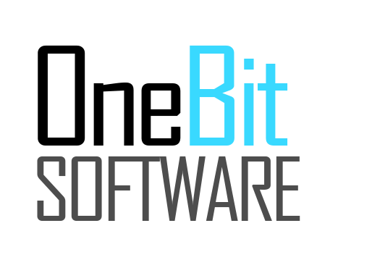


SoftUni Organizational Partners

Slide 31





Trainings @ Software University (SoftUni)
Software University - High-Quality Education, Profession and Job for Software Developers
softuni.bg
Software University Foundation
http://softuni.foundation/
Software University @ Facebook
facebook.com/SoftwareUniversity
Software University Forums
forum.softuni.bg

